Slide 1

Presented by: David Kornhauser, Andrae Marrocco, and Ashley Caldwell

Slide 2
Why Earnings Projections are significant
Prospective franchisees care about anticipated return on investment
Reliable financial information helps evaluate that return

Slide 3
Why Franchisors may choose not to provide Earnings Projections
Performance often varies significantly by:
Location
Market conditions
Franchisee skill and effort
Seasonal trends
Economic disruption reduces the reliability of historical performance

Slide 4
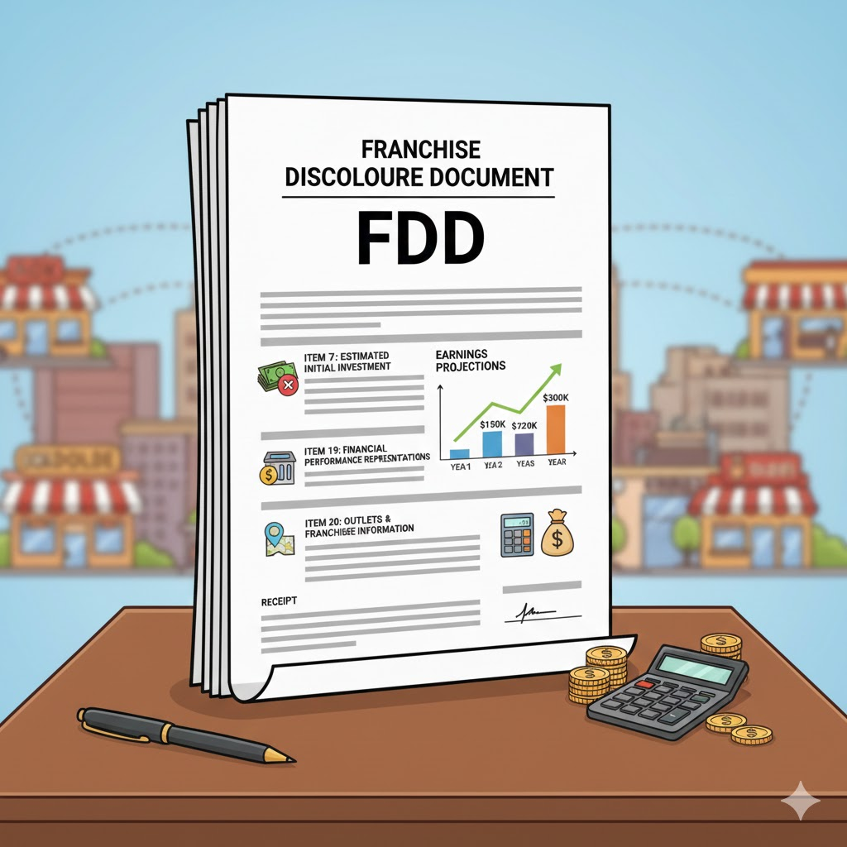
Legal Framework (Ontario)
If Earnings Projections are provided, s. 6(3) of the Regulation requires:
a statement specifying the reasonable basis for the earnings projection; the assumptions underlying the Earnings Projection;
the assumptions underlying the Earnings Projection; and
a location where substantiating information is available for inspection of the Earnings Projection.

Slide 5

What is an Earnings Projection?
Ontario Regulation does not define “Earnings Projection”
Other provinces define it broadly as any information from which specific performance (sales, costs, profits, etc.) can be easily ascertained

Slide 6

Apblouin Imports Ltd. v. Global Diaper Services Inc.; and Giroux et al. v. 1073355 Ont. Ltd. et al
Courts have found disclosure documents to be materially deficient when elements required under s6(3) of the Regulation were missing.
Global Diaper:
No statement identifying where substantiating information could be inspected
Giroux:
Graphs of franchisee earnings included in the disclosure document qualified as financial projections

Slide 7

2212886 Ontario v. Obsidian Group
Once financial performance information is given outside of the disclosure context, the information must then be included in the formal disclosure document.
The omission of such information amounts to deficient disclosure, triggering a rescission right under s. 6(2) of the Act.

Slide 8

Role of the Lawyer in Preparing Earnings Projections
Lawyers do not prepare financial projections.
The lawyer’s role is to ensure the disclosure document complies with s. 6(3) of the Regulation:
Reasonable basis
Assumptions
Location for substantiation
Questions for lawyers:
Should they assess whether the basis is actually reasonable?
Should they evaluate whether assumptions are reasonable?
Should they verify the substantiating information exists?

Slide 9
Best Practices for Preparing and Presenting Earnings Projections

Slide 10

Designing complianT earnings projections

Slide 11
Historical Performance
Future Forecast

Slide 12
Establishing a “Reasonable Basis”
Historical performance of company-owned units
Historical performance of franchised units
Industry benchmarks and market studies
Hybrid approaches combining multiple sources

Slide 13

Critical Considerations
Sample Size Matters
• Use the largest representative sample possible
• Clearly disclose number of units included
• Explain any selection or exclusion criteria
Time Period Selection
• Balance recency vs. representativeness
• Consider multi-year trend data
• Address disruption-period performance

Slide 14

Articulating Clear and Defensible Assumptions
Key Categories:
Economic conditions & market factors
Operational assumptions
Geographic & demographic variables
Franchisee skill & effort levels
Start-up period & ramp-up timelines
Assumptions vs. Disclaimers
Assumptions define conditions under which results might be achieved
Disclaimers warn about limitations and risks
Effective assumptions are:
Specific and measurable
Directly related to projections
Not vague generalizations

Slide 15
Scope & Format Decisions
What to Include:
Revenue only vs. comprehensive profit projections
Percentage of franchisees achieving results
Performance range (top to bottom)
Unit closure rates
Time Horizons:
First-year projections (start-up challenges)
Steady-state projections (mature operations)

Slide 16
The Fatal Flaw: Location Statement
Most Common Compliance Failure
Omission of location statement = material deficiency = rescission right
Vague statements are insufficient:
"Available at franchisor's offices"
"Available upon request"
What Makes an Adequate Location Statement?
Must Include:
Specific address
Business hours
Contact person (name, title, phone, email)
Advance notice requirements
Must Be Accessible:
Geographically reasonable
Temporally reasonable
Procedurally reasonable

Slide 17

Integration into the FDD
Single Document Requirement
All earnings projections must be:
In the appropriate FDD section
Clearly labeled and easy to locate
Presented in their entirety (not by reference)
Consistent with other FDD sections
Avoid:
Supplementary documents outside the FDD
Financial representations in sales presentations not in FDD
"Tiered" disclosure with selective information

Slide 18

Updating Projections
Ongoing Obligation
Updates required when:
Material changes in system performance
Existing projections become misleading
Basis for projections becomes stale
Balance:
Need for current information
Practical challenges of frequent revisions

Slide 19
Crafting Effective Disclaimers
Essential Elements:
Projections are estimates; actual results will vary
No guarantee franchisees will achieve results
Key variables that may cause differences
Encourage independent analysis
Percentage of franchisees achieving results
Placement:
Prominent but not overwhelming
Specific rather than generic
Balanced in tone

Slide 20
Controlling Communications Beyond the FDD
Critical Risk Area
Financial information provided outside FDD must be included in formal disclosure
Protective Measures:
Train all sales personnel
Develop standardized responses
Implement "refer to FDD" policy
Maintain communication records
Control franchise brokers and third parties

Slide 21

Documentation & Record-Keeping
Substantiation Files Should Include:
Raw financial data for all units
Detailed calculations
Documentation of assumptions
Third-party reports relied upon
Internal decision memoranda
Retention Period:
While disclosure document is in use
Plus applicable statute of limitations

Slide 22
Special Considerations: Unstable Economic Times
Recent Disruptions:
Pandemic-related impacts
Supply chain volatility
Inflation & tariff changes
AI-driven transformations
Approach:
Present multi-period data (pre/during/post disruption)
Consider scenario-based presentations
Be transparent about limitations
Transparency in Uncertain Times
Key Principles:
Identify factors creating uncertainty
Explain how they might affect performance
Provide context on navigating recent challenges
Maintain balanced tone
Use current cost levels, not historical averages
Provide ranges for volatile categories
Encourage Independent Due Diligence
Best Practices:
Recommend consultation with advisors
Facilitate contact with existing franchisees
Provide access to substantiating information
Encourage market research and financial analysis
Allow adequate time before commitments

Slide 23

Conclusion: Excellence as Competitive Advantage
Benefits of Compliant, Transparent Projections:
Build trust with prospective franchisees
Attract qualified candidates
Set realistic expectations
Reduce future disputes
Foundation for successful relationships
In unstable times, transparency differentiates your system

Slide 24
Hypothetical Earnings Projection

Slide 25

Enclosed please find Earnings Projection for CAMOKO Restaurants. There is one Earnings Projection based on three different sales histories, as follows:
Based on the actual results of operations of its franchisees and corporate locations across Canada coinciding with a pre-COVID period. The actual results of operations could be presented on their own as historical data.
Based on the results of operations of its franchisees and corporate locations across Canada coinciding with a post-COVID period. To present the Earnings Projection based COMOKO Restaurants must detail the various assumptions which management believe reflects the most likely outcome of events.
Based on the results of operations of its franchisees and corporate locations across Canada coinciding with the period from 2025 to 2027 – this is a future period in which we anticipate lower sales, based on a tightening of consumer spending and increased costs. To present the Earnings Projection based COMOKO Restaurants must detail the various assumptions which management believe reflects the most favourable outcome of events.

Slide 26
The following explanations should be included in providing any Earnings Projection:
The period of time covered by the Earnings Projection (if based on historical data)
Identify whether the Earnings Projection represents: (i) actual results of operations (Actual Financial Results for the CAMOKO Restaurant Franchise System for Pre-COVID Years); (ii) an earnings projection based on actual results (Earnings Projection for the CAMOKO Restaurant Franchise System); (iii) an Earnings Projection based on assumptions which the franchisor believes reflects the most likely outcome of events (Actual Financial Results for the CAMOKO Restaurant Franchise System for Post-COVID Years); and (iv) an Earnings Projection based on assumptions which management believe reflects the most favourable outcome of events (Actual Financial Results for the CAMOKO Restaurant Franchise System for the Recession/Increased Cost Years)
The material assumptions underlying the Earnings Projection. The assumptions and hypotheses that should be included will depend on the actual historical data available at the time that the Earnings Projection is being prepared.
Whether the Earnings Projection is based on the actual results of all existing franchisees (how many) and/or corporate locations (how many); or only a select number of existing franchisees (how many) and/or corporate locations (how many)
Identify whether any franchisees are multi-unit franchisees (they may have greater economies of scale in respect of purchasing and/or labour)
Identify what differences, if any, there are between the operation of a franchised restaurant and a corporate owned restaurant
State, as a percentage, the number of restaurants that have achieved or surpassed the amounts set forth in the Earnings Projection, and where each of these restaurants are located
If Earnings Projections are based on a select number of franchisees and/or corporate locations then include: (i) the nature and number of franchisees and/or corporate locations forming the select group; (ii) an explanation as to why the specific group of franchisees and/or corporate locations were selected; (iii) an explanation of the differences between the information obtained from the selected group might differ from the restaurant being acquired by the prospective franchisee.
The reasonable basis for the Earnings Projection

Slide 27
EARNINGS PROJECTIONS
Other than as set out below, the Franchisor does not furnish or authorize our employees or anyone else to furnish any oral or written information concerning the actual or potential sales, costs, income or profits or other historical results, projections or otherwise (or representations regarding any working capital or other funds necessary to reach any “break-even” or any other financial level) of a CAMOKO Restaurants franchise. Since actual results vary from territory to territory, we cannot estimate the results of any particular franchise and cannot reliably predict, forecast or project future performance, gross revenues, earnings, profits or otherwise of any CAMOKO Restaurants franchise, including ones owned and/or operated by us, due to the large number of factors outside our control. We certainly cannot predict what your results might be.
Other than as set out below, if any such information, promises, representations and/or warranties have been provided to you, they have not been authorized, they should not be relied on, we will not be bound by them, and, if you do rely on such information, promises, representations and/or warranties, you do so at your own risk. If, however, any of our employees do furnish you with any oral or written information concerning the actual or potential sales, costs, income or profits or other historical results, projections or otherwise of a CAMOKO Restaurants franchise, we urge you to immediately notify Ashley Caldwell, Andrae Marrocco or David Kornhauser, in writing, with respect to such information prior to the purchase of your CAMOKO Restaurants franchise, that is, prior to the signing of your Franchise Deposit Agreement and/or Franchise Agreement, as the case may be. Ms. Caldwell can be reached via email at ashley@camoko.ca, Mr. Marrocco can be reached via e-mail at andrae@camoko.ca, and/or Mr. Kornhauser can be reached via email at david@camoko.ca.

Slide 28
Hypotheses and Assumptions to CAMOKO Restaurants Earnings Projections
Introduction
The purpose of the presentation of this Earnings Projection is to provide additional information to prospective franchisees based on assumptions and hypotheses outlined below. The following assumptions were developed by management.
Variations and Changes to the Earnings Projections
While every attempt has been made to accurately prepare earnings projections actual results achieved are likely to vary from the Earnings Projection presented, and this variation could be material. There is no assurance of any future earnings in respect of any actual or proposed CAMOKO Restaurant.
Risk
Management considers the following material risk factors that could cause actual results to differ materially from the forward-looking information:
Level of prior knowledge/success in managing personnel; prior restaurant industry experience of the Franchisee and their employees;
General competition in the marketplace; and
The Franchisees’ ability to: (i) effectively manage and operate a restaurant; (ii) control labour costs; (iii) ability to staff the restaurant.

Slide 29
Hypotheses/Assumptions
The Earnings Projections assume the following:
Total investment required is $700,000.00 comprising $500,000.00 in bank financing (“Bank Financing”) repayable over a 5-year period; and $200,000.00 for other miscellaneous expenses including the franchise fee, opening inventory, training costs, opening marketing and advertising, etc.
An average restaurant Size of 2,500 sq. ft. with seating for ~ 60 customers; 360 days of operation/year; an average of 300 customers/day; an average check size: of $12.00 (food + beverage); annual growth of 5% (due to brand recognition, marketing, and inflation)
Gross Revenues are net of any third-party delivery costs (which have been excluded for the purposes of this analysis).
Assumes 70% dine in, 30% take-out and/or third-party delivery.
Gross rental rate for both minimum rent and additional rent of $48.00 per square foot.
Other Operating expenses cover all miscellaneous expenses including legal/accounting fees; fees for high-speed internet access, health/benefit plans; telephones; meals & entertainment; external software.
Bank Financing is at an interest rate of six percent (6%) per annum.
Straight-line depreciation for capital expenses (total $500,000.00) is over a 10-year period which allows Franchisee to deduct depreciation allowance of $50,000.00/year. This amount is deducted in order to determine the amount of taxes due and owing; and is added back in to determine cash flow.
Twenty percent (20%) combined federal and provincial tax rate.

Slide 30
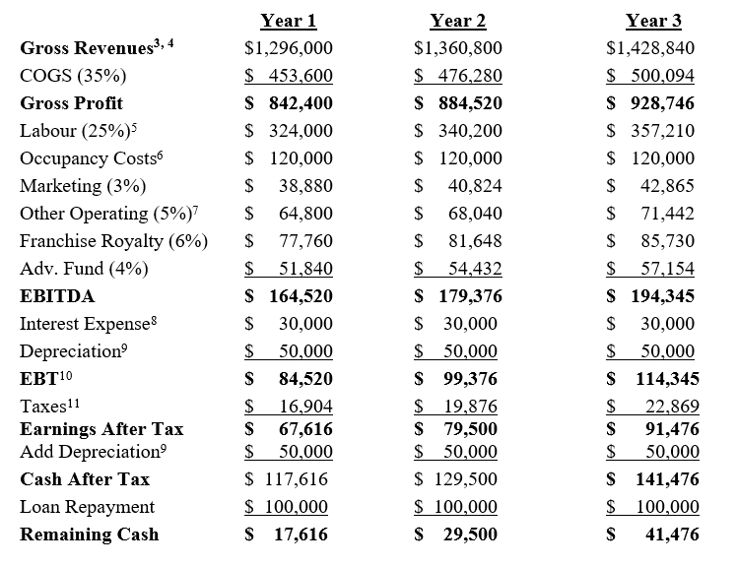
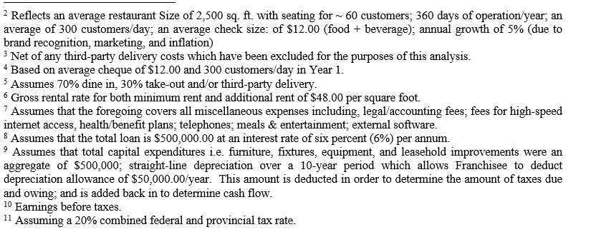
Earnings Projection for the CAMOKO Restaurant Franchise System²

Slide 31
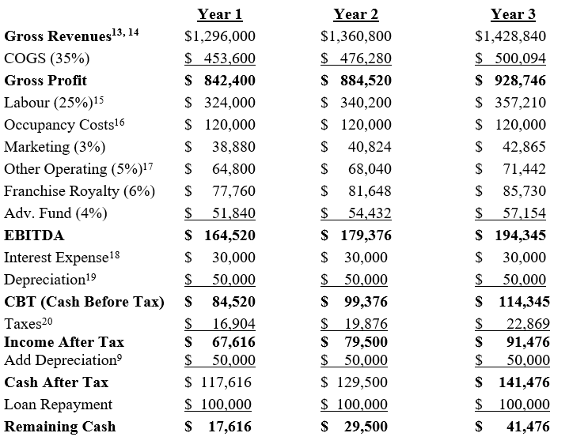
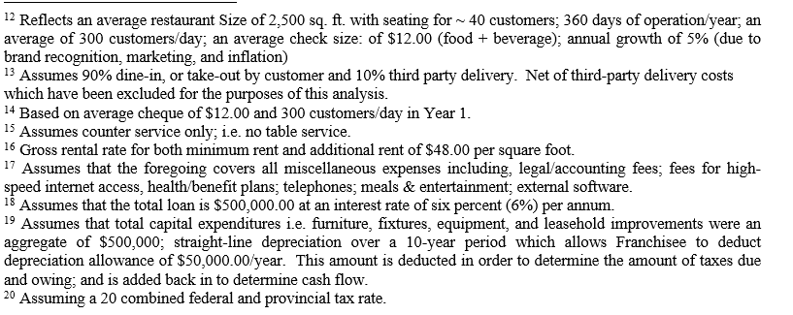
Actual Financial Results for the CAMOKO Restaurant Franchise System for Pre-COVID Years¹²

Slide 32
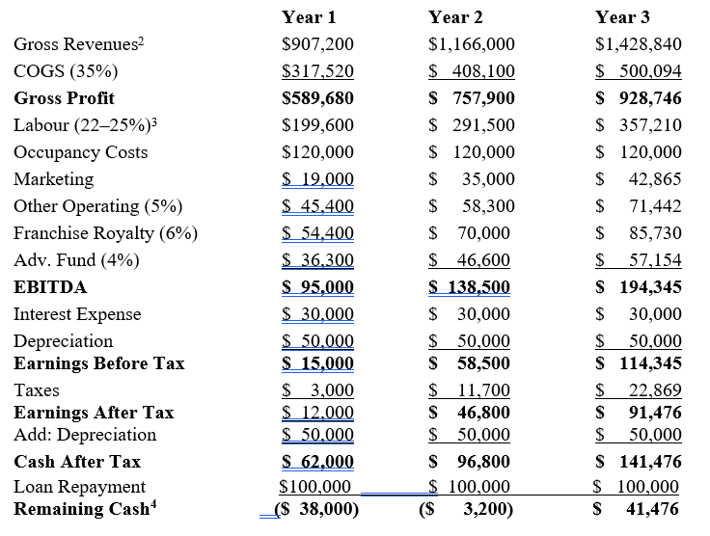
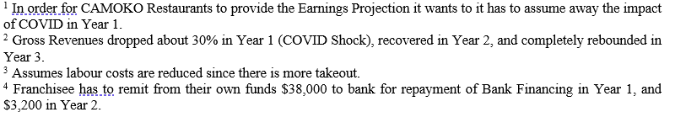
Actual Financial Results for the CAMOKO Restaurant Franchise System for Post-COVID Years¹

Slide 33
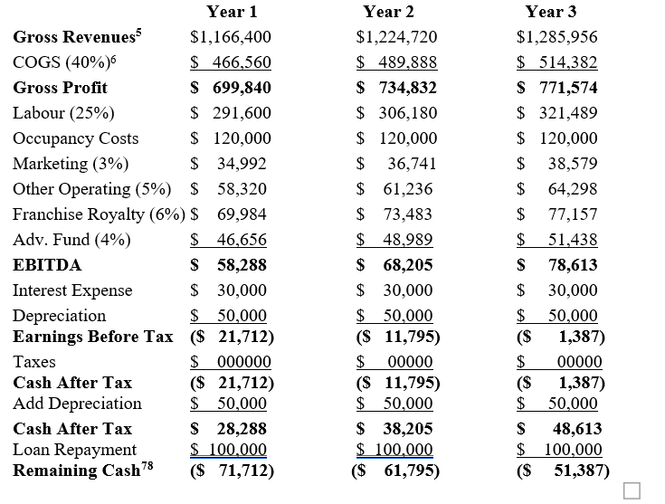
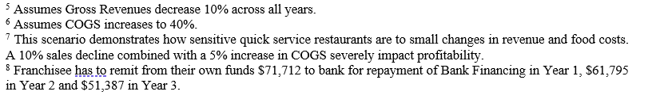
Actual Financial Results for the CAMOKO Restaurant Franchise System for the Recession/Increased Cost Years

