Slide 1
Franchising in the Modern Marketplace: Franchise Basics in the USA and Canada
Kendal Tyre (Nixon Peabody LLP – Washington, DC)
Jeffery M. Cross (Smith Gambrell Russell, LLP - Chicago)
Andrae Marrocco (McMillan LLP – Toronto)
W. Brad Hanna (McMillan LLP – Toronto)

Slide 2
Agenda
Statutory Definition of Franchise
In the USA – Kendal
In Canada – Andrae
The “Accidental” Franchisor
In the USA – Jeff
In Canada – Andrae
The Regulatory Framework – the FDD, Registration and Exemptions/Exceptions
In the USA – Jeff
In Canada – Andrae
The Duty of Fair Dealing and Good Faith
In the USA – Kendal
In Canada – Brad

Slide 3
Statutory Definition of Franchise in the USA
Governing Law:
The Federal Trade Commission (FTC) Franchise Rule
Key Components:
Trademark: The franchisee is granted right to operate under the franchisor's trademark or trade name.
Significant Control or Assistance: The franchisor exerts significant control over, or provides significant assistance in, the franchisee's method of operation.
Required Payment: The franchisee must pay the franchisor a fee or other compensation.

Slide 4
Statutory Definition of Franchise in the USA
U.S. State Overview:
Some states have their own definitions and regulations for franchises.
Examples:
New York Franchise Sales Act
California Franchise Investment Law
Key Differences:
Specific state laws and regulations
Registration requirements
Additional disclosure requirements

Slide 5
Statutory Definition of Franchise in Canada
6 Canadian provincial statutes
“Franchise”
3-Elements (Test)
the obligation to make one or more payments (“Payment Element”);
the right to conduct and operate a business that is substantially associated with a trademark (“Trademark Element”); and
the exercise of significant control or the offer of significant assistance in the method of operation (“Control or Assistance Element”).
Exemptions

Slide 6
The Accidental Franchisor in the USA
A difference between franchising and distribution
With franchising, more than distribution is in the hands of the franchisee
The franchisee is involved in some or all of the manufacturing or creation process

Slide 7
The Accidental Franchisor in the USA
The franchisee is independent of the franchisor
Therefore, the franchisor imposes restraints on the franchisee to ensure that a quality product is produced
Marketing plan
Use of system
Restrictions on purchases of ingredients

Slide 8
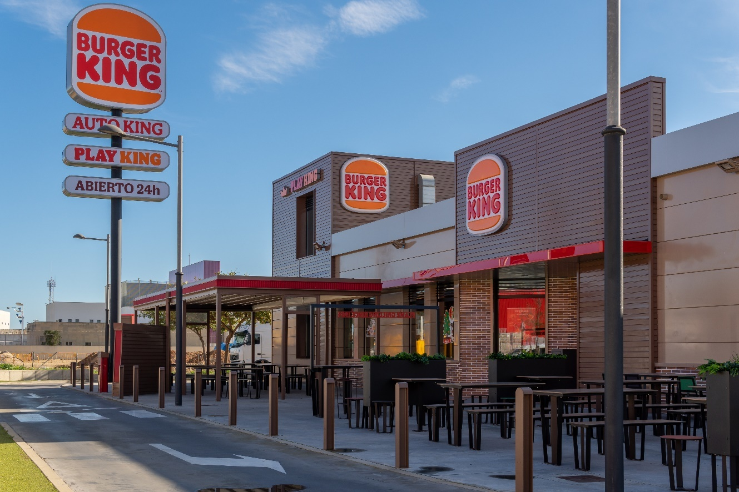
The Accidental Franchisor in the USA
Burger King is the quintessential franchisor

Slide 9
The Accidental Franchisor in the USA
There is a wide range in the manufacturer’s requirements for distribution

Slide 10
The Accidental Franchisor in the USA
The “Accidental Franchise” Problem
When do restrictions on distributor establish a franchise
Eighteen states have franchise laws
Many with different definitions of “franchise”

Slide 11
The Accidental Franchisor in the USA
Illinois Franchise Disclosure Act
“Franchise” means a contract or agreement. either expressed or implied whether oral or written, between two or more persons by which:
a franchisee is granted the right to engage in the business of offering, selling, or distributing goods or services, under a marketing plan or system prescribed or suggested in substantial part by a franchisor; and
the operation of the franchisee's business pursuant to such plan or system is substantially associated with the franchisor's trademark, service mark, trade name, logotype, advertising, or other commercial symbol designating the franchisor or its affiliate; and
the person granted the right to engage in such business is required to pay, directly or indirectly, a franchise fee of $500 or more. . . .
815 Ill. Comp. Stat. 705/3(1) (Supp. 1997).

Slide 12
The Accidental Franchisor in the USA
Connecticut Statute:
A franchise is “an oral or written agreement or arrangement in which (1) a franchisee is granted the right to engage in the business of offering, selling or distributing goods . . . under a marketing plan or system prescribed in substantial part by a franchisor . . . and (2) the operation of the franchisee’s business pursuant to such plan or system is substantially associated with the franchisor's trademark, service mark, trade name, logotype, advertising or other commercial symbol designating the franchisor or its affiliate . . . .”
Conn. General Statute § 42-133e (b)

Slide 13
The Accidental Franchisor in the USA
The problem of the “accidental franchise:
Courts have interpreted a manufacturer’s restraints on a distributor to create an unintended franchise.
A good example is Hartford Electric Supply Co. v. Allen-Bradley Co., 736 A. 2d 824 (1999)

Slide 14
The Accidental Franchisor in the USA
Manufacturer’s restraints on a distributor that were deemed to be a marketing plan:
Requirement that distributor prepare a business plan
Power over pricing
Power over hiring and firing franchisee’s personnel
Power to require training of franchisee’s personnel
Control over franchisee’s inventory
Power to examine franchisee’s financial records and to require an audit

Slide 15
The Accidental Franchisor in the USA
Federal court interpreting Connecticut statute made the following point:
“There is no precise formula as to how many of such factors must exist in the aggregate, before the control exercised by a manufacturer rises to a marketing plan on system presented in substantial part by a franchisor.”
Sorisio v. Lenox, Inc., 701 F. Supp. 950 (D. Conn. 1988), aff’d 863 F. 2d 195 (2d Cir. 1988)

Slide 16
The Accidental Franchisor in the USA
Example of a factor that poses risk that a distribution scheme may be deemed a franchise:
Interpretation of pricing factor in Hartford Electric:
Held by Connecticut Supreme Court to be “one of the significant criteria for determining control” indicative of a franchise
“The trial court found that the defendant [manufacturer] effectively controls the prices that plaintiff [distributor] can charge its customers for the defendant’s products.”
Trial court found that the “franchisee only had limited discretion as to the prices because franchisor presented prices on goods packages.”

Slide 17
The Accidental Franchisor in the USA
Pricing (cont.):
“The defendant also publishes a catalog of its products, which the plaintiff, in turn, uses in its sales efforts. This catalog lists a ‘manufacturer’s suggested price’ for each item.”
“[s]elling the defendant’s products below their listed catalog price is not commercially viable because of the resulting reduction in the plaintiff’s profit margin.”

Slide 18
The Accidental Franchisor in the USA
Even if there is a definition of franchise like that in Illinois:
The practitioner should be wary
One Illinois court has held that the payment for manuals is a franchise fee

Slide 19
The Accidental Franchisor in Canada
3 Elements (Test)
the obligation to make one or more payments (“Payment Element”);
the right to conduct and operate a business that is substantially associated with a trademark (“Trademark Element”); and
the exercise of significant control or the offer of significant assistance in the method of operation (“Control or Assistance Element”).
Distribution Arrangements (Review Exercise)
Consequences

Slide 20
The Regulatory Framework in the USA
The regulatory framework agenda:
Disclosure
Registration
Exemptions/Exceptions
Termination and nonrenewal statutes

Slide 21
The Regulatory Framework in the USA

Slide 22
The Regulatory Framework in the USA
Disclosure Laws
Modeled on SEC disclosures to facilitate due diligence by prospective franchisees
Example is list of current and prior franchisees for prospective franchisee to contact
Disclosure document must be provided to prospective franchisee before sale of franchise

Slide 23
The Regulatory Framework in the USA
Registration
Register franchise with state franchise administrator
Include disclosure document
Include franchise agreement
Include statements required by specific state statute
Registration reviewed by state franchise administrator

Slide 24
The Regulatory Framework in the USA
State franchise laws regarding termination and nonrenewal
e.g., Illinois, 815 ILCS 705/19
“(a) It shall be a violation of this Act for a franchisor to terminate a franchise of a franchised business located in this state prior to the expiration of its term except for ‘good cause’ as provided in subsection (b) or (c) of this section.”

Slide 25
The Regulatory Framework in the USA
Disclosure Laws
FTC Rule
Disclosure required pre-sale
No registration
State laws
Registration and disclosure

Slide 26
The Regulatory Framework in the USA
State Pre-sale Registration and Disclosure Laws:
California North Dakota
Hawaii Oregon
Illinois Rhode Island
Indiana South Dakota
Maryland Virginia
Michigan Washington
Minnesota Wisconsin
New York

Slide 27
The Regulatory Framework in the USA
State Business Opportunity Laws:
Alaska Kentucky North Carolina
California Louisiana Ohio
Connecticut Maine Oklahoma
Florida Maryland South Carolina
Georgia Michigan South Dakota
Illinois Minnesota Texas
Indiana Nebraska Utah
Iowa New Hampshire Virginia
Washington

Slide 28
The Regulatory Framework in the USA
FTC Rule
Originally passed in 1978
Statement of Basis and Purpose, 16 C.F.R. Part 436
Pre-sale disclosure required but not registration
Amended in 2007
Pre-empts state law if state law inconsistent with FTC Rule

Slide 29
The Regulatory Framework in the USA
North American Securities Administrators Association (NASAA)
2008 NASAA Guidelines incorporate disclosure requirements of FTC Rule
NASAA Guidelines adopted additional disclosure requirements
NASAA Guidelines adopted by each of Franchise Registration and Disclosure states
NASAA Disclosure Document now called Franchise Disclosure Document (FDD)
Deemed compliant with FTC Rule

Slide 30
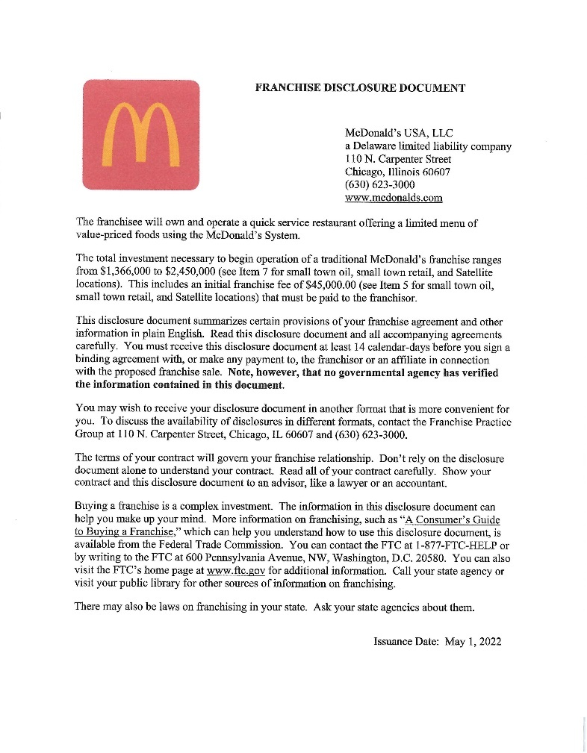
The Regulatory Framework in the USA
Types of Information Required by FDD:
Cover page

Slide 31
The Regulatory Framework in the USA
Types of Information Required by FDD (cont.):
Cover page
The Franchisor and any parents, predecessors and affiliates
Business experience
Litigation
Bankruptcy
Initial Fees
Other Fees
Estimated initial investment
Restrictions on sources of products and services

Slide 32
The Regulatory Framework in the USA
Types of Information Required by FDD (cont.):
Franchisee’s obligations
Financing
Franchiser’s assistance, advertising, computer systems, and training
Territory
Trademarks
Patents, copyrights, and proprietary information
Obligation to participate in the actual operation of the franchisee business

Slide 33
The Regulatory Framework in the USA
Types of Information Required by FDD (cont.):
Restrictions on what the franchisee may sell
Renewal, termination, transfer, and dispute resolution
Public figures
Financial performance representations
Outlets and franchise information
Financial statements
Contracts
Franchise agreement
Certain disclosures required by state law

Slide 34
The Regulatory Framework in the USA
Registration
Most registration states require the filing of the FDD as part of the registration application
Some but not all states review the FDD and exhibits to confirm they meet requirements of state law
Registrations must be renewed

Slide 35
The Regulatory Framework in the USA
Exemptions from Disclosure:
Transactions involving large investments
Sophisticated investors
Franchisor insiders
Fractional franchisees
Relationships covered by special statutes (e.g. PMPA)
When franchisee sells its own franchise unless franchisor significantly involved or unless franchise agreement terms materially changed
Pre-sale disclosure required if franchisor requires new franchisee to sign the current franchise agreement

Slide 36
The Regulatory Framework in the USA
Exemptions (cont.)
In some circumstances, renewals, contract amendments, or the opening of additional outlets may not require disclosure under state laws, but disclosures may be required under RTC Rule
Exemption distinction between federal and state rules
Under FTC Rule, if exemption, no disclosure required
Under state laws, exemption from registration but disclosure may still be required

Slide 37
The Regulatory Framework in Canada
6 Canadian provincial statutes
Franchises Act, RSA 2000, c F-23 (Alberta Act)
Franchises Act, SBC 2015, c 35 (British Columbia Act)
The Franchises Act, SM 2010, c 13 (Manitoba Act)
Franchises Act, RSNB 2014, c 111 (New Brunswick Act)
Arthur Wishart Act (Franchise Disclosure), 2000, SO 2000, c 3 (Ontario Act)
Franchises Act, SPEI 2005, c 36 (Prince Edward Island Act)
The Franchise Disclosure Act (Saskatchewan Act) received royal assent on May 8, 2024 (yet to come into force)
3 Primary Obligations
Self-Regulated
No Registration
Franchise Opportunity Specific

Slide 38
The Duty of Fair Dealing and Good Faith in the USA
In the United States, the duty of good faith is not always guaranteed.
Its prevalence can vary greatly depending on jurisdiction and applicable law.
It holds parties accountable for carrying out the performance of their respective duties under a contract with “honesty in fact in the conduct or transaction concerned.”

Slide 39
The Duty of Fair Dealing and Good Faith in the USA
Under the common law, most state courts either :
find an implied duty of good faith to be inherent in all contracts, including franchise agreements, or
solely apply the duty of good faith in limited circumstances such as in the termination and renewal of franchise relationship.
Fewer states allow parties to utilize express contractual provisions to eliminate or invoke the duty of good faith within the franchise agreement.

Slide 40
The Duty of Fair Dealing and Good Faith in the USA
However, Texas typically rejects the notion that a franchisor and franchisee have required special relationship for the good faith requirement to apply, and thus, denies all damages sought for breach of the same.
Conversely, some U.S. states enforce the duty of good faith within franchise relationships through statutory law. Moreover, its application can also depend on the type of product or service the franchise agreement covers:
Petroleum
Motor vehicles; or
Various types of equipment.

Slide 41
The Duty of Good Faith and Fair Dealing in Canada
All provincial franchise legislation imposes a statutory duty of fair dealing.
Quebec’s Civil Code imposes a good faith requirement on all contracting parties.
The duty in Ontario’s franchise legislation reads:
3 (1) Every franchise agreement imposes on each party a duty of fair dealing in its performance and enforcement.
(2) A party to a franchise agreement has a right of action for damages against another party to the franchise agreement who breaches the duty of fair dealing in the performance or enforcement of the franchise agreement.
(3) For the purpose of this section, the duty of fair dealing includes the duty to act in good faith and in accordance with reasonable commercial standards.

Slide 42
Preliminary Points and General Principles
Not a fiduciary obligation.
Applies by operation of law – cannot be contracted out of.
Breach of the duty gives rise to an action for damages and joint/several liability.
Cause of action is independent from breach of contract. Can have one or the other or both.

Slide 43
Preliminary Points and General Principles
Does not permit court to rewrite agreement or override express terms
The duty of good faith and fair dealing and the duty to act in accordance with reasonable commercial standards, as expressed in the Arthur Wishart Act, relate to the performance and enforcement of the franchise agreement. The duty is imposed in order to secure the performance of the contract the parties have made. It is not intended to replace that contract with another contract or to amend the contract by altering the express terms of the franchise contract.
It follows from this that in assessing whether a party has demonstrated good faith and fair dealing in the performance and enforcement of the agreement, the party’s conduct must be considered in the context of and in conjunction with the contract that the parties have made. It is not a stand-alone duty that trumps all other contractual provisions.
Fairview Donut Inc v The TDL Group Corp, 2012 ONCA 867, paras 500-501

Slide 44
Preliminary Points and General Principles
Courts will consider all the circumstances when assessing “reasonable commercial standards”.
For all practical purposes, the franchise-specific statutory duty of fair dealing gives rise to largely the same obligations as the duty of good faith in Canadian contract law.

Slide 45
Content of the Duty of Fair Dealing
Highly context and fact-specific.
In practice, the duty is more onerous on franchisors.
Bad faith and unfair dealing claims frequently arise in the context of disclosure, franchise termination and non-renewal, refusals to consent to franchisee transfers and other contexts.

Slide 46
Content of the Duty of Fair Dealing
Must exercise powers under the franchise agreement in good faith and with due regard to the interests of the franchisee.
Must observe standards of honesty, fairness and reasonableness.
Must not act in a way that “eviscerates or defeats the objectives of the agreement”.
Must not substantially nullify the benefit contracted for, or cause significant harm to, your counterparty contrary to the original purpose and expectation of the parties.
Must exercise discretionary contractual powers “reasonably and with proper motive” and not “arbitrarily, capriciously, or in a manner inconsistent with the reasonable expectations of the parties”.
May act in self-interested manner but in doing so must have regard for the counterparty’s legitimate interests.
Fairview Donut Inc v The TDL Group Corp, 2012 ONCA 867

Slide 47
Examples of Breaches of the Duty of Fair Dealing
Supplying a competitor with product within the franchisee’s territory that eventually put the franchisee out of business
Exercising an express contractual right of termination arbitrarily or for collateral, ulterior motives
Refusing to provide a right of first refusal on a nearby location to a franchisee who wanted to relocate, and instead awarding the location to a new franchisee
Knowingly misrepresenting the terms of the franchise agreement
Failing to give the proper amount of notice of termination as required by the franchise agreement
Withholding information from a franchisee and failing to respond promptly to inquiries
Failing to provide adequate disclosure on the renewal or extension of a franchise agreement when there has been a material change
Failing to take reasonable measures to protect and enhance the brand

Slide 48
Examples Where There is No Breach of the Duty
A franchisor who chose not to renew a franchise agreement that contained no renewal clause
A franchisor refused to waive royalty payments to which it was expressly entitled under the franchise agreement
A franchisor who imposes system changes that were expressly authorized by the franchise agreement in circumstances where it considered the interests of its franchisees
When a financially distressed franchisor terminates numerous franchisees for valid economic reasons

Slide 49
Thank you.
Kendal Tyre (Nixon Peabody LLP – Washington, DC)
Jeffery M. Cross (Smith Gambrell Russell, LLP - Chicago)
W. Brad Hanna (McMillan LLP – Toronto)
Andrae Marrocco (McMillan LLP – Toronto)

Slide 50
Q&A

